Slide 1
FIRST MAGNETOHYDRODYNAMIC SIMULATIONS OF JETS AND RADIATIVE FEEDBACK FROM A MASSIVE STAR
Joshua Barquero Alvarado$1,2$
Phd Student, Astrophysics
Universität Duisburg-Essen
R. Kuiper$1,4$, A. Oliva$1$
Supervisor$4$
Collaborator, University of Duisburg-Essen$1$

Slide 2
Outline
Massive Stars and their enviroment
Description of the model
Results
Methodology
Conclusion

Slide 3
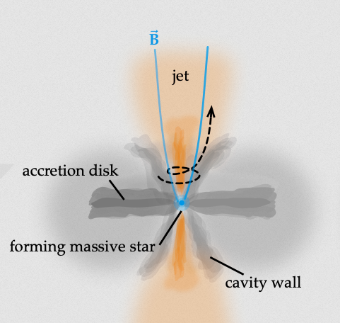
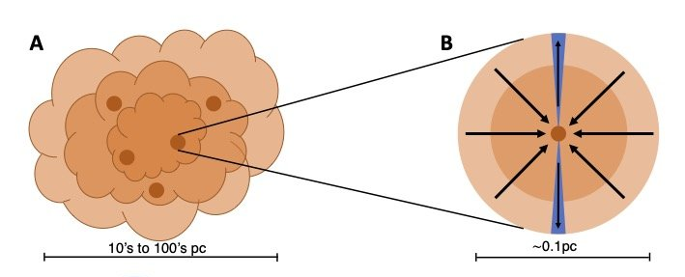
Stellar Feedback
Massive Stars and their natal environment
$M_{∗ }>$ ${\text{8} M}_{⊙}$in the main sequence
Process where stars influence their surrounding through various mechanisms:
Their luminosities are significant higher, $\sim {10}^{3} L_{ ⊙}$, compared to the common low mass stars.
Radiative Feedback
Mechanical Feedback
Gravitational Collapse
ionizing radiation
+
Non-ionizing radiation
Cloud
Star
Inside the collapsing core
Radiation pressure matters!
Credits: A. Labdon
Credits: A. Oliva

Slide 4
Methodology
Physical Effects
Program/Module
MHD
PLUTO¹
¹Mignone et al. (2007). PLUTO: A Numerical Code for Computational Astrophysics. ApJs
Ohmic dissipation
Model from Machida et al. (2007)
Stellar Evolution
Computed from the stellar tracks from Hosokawa et al. (2009)
Self-gravity
²Kuiper et al. (2010). Circumventing the Radiation Pressure Barrier in the Formation of Massive Stars via Disk Accretion. ApJs
HAUMEA²
Radiation Transport
MAKEMAKE³
Irrad. Heating and Forces
³Kuiper et al. (2018). Makemake + Sedna. A Continuum Radiation Transport and Photoionization Framework for Astrophysical Newtonian Fluid Dynamics. ApJs
Photo-ionization
SEDNA³
Thermodynamics and Recombination

Slide 5
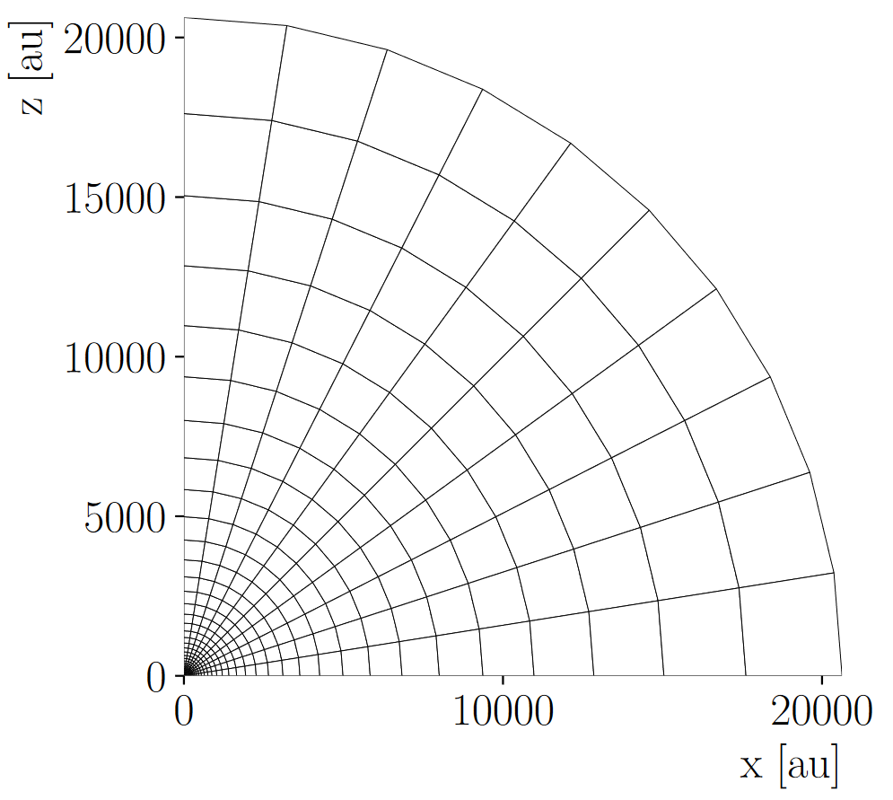
Description of the model
Initial conditions of the collapse
Cloud of radius 0.1 pc and 100 $M_{⊙}$
$$ρ \left(r, t=0\right) ∝ r^{−1.5}$$
Density
$$Ω\left(R, t=0\right) :const;$$
$$E_{rot} /E_{grav}=0.04$$
Rotation
$$\vec{B} \left(r, t=0\right)=B_{0} \hat{z}$$
Magnetic Field
$\overline{μ}≡\frac{M_{c} / ϕ_{B}}{{\left(M_{c} /Φ_{B}\right)}_{crit}}$ $=20$
$$Ω$$
$$B_{0}$$
This magnetic flux $Φ_{B}=B_{0}⋅πR_{c}^{2}$ is computed across the midplane.

Slide 6
Only MHD
Only Irrad. Heating
Irrad. Force + Hea.
Photo. + Irrad. Heating
Photo. + Irrad. Force +H.

Slide 7
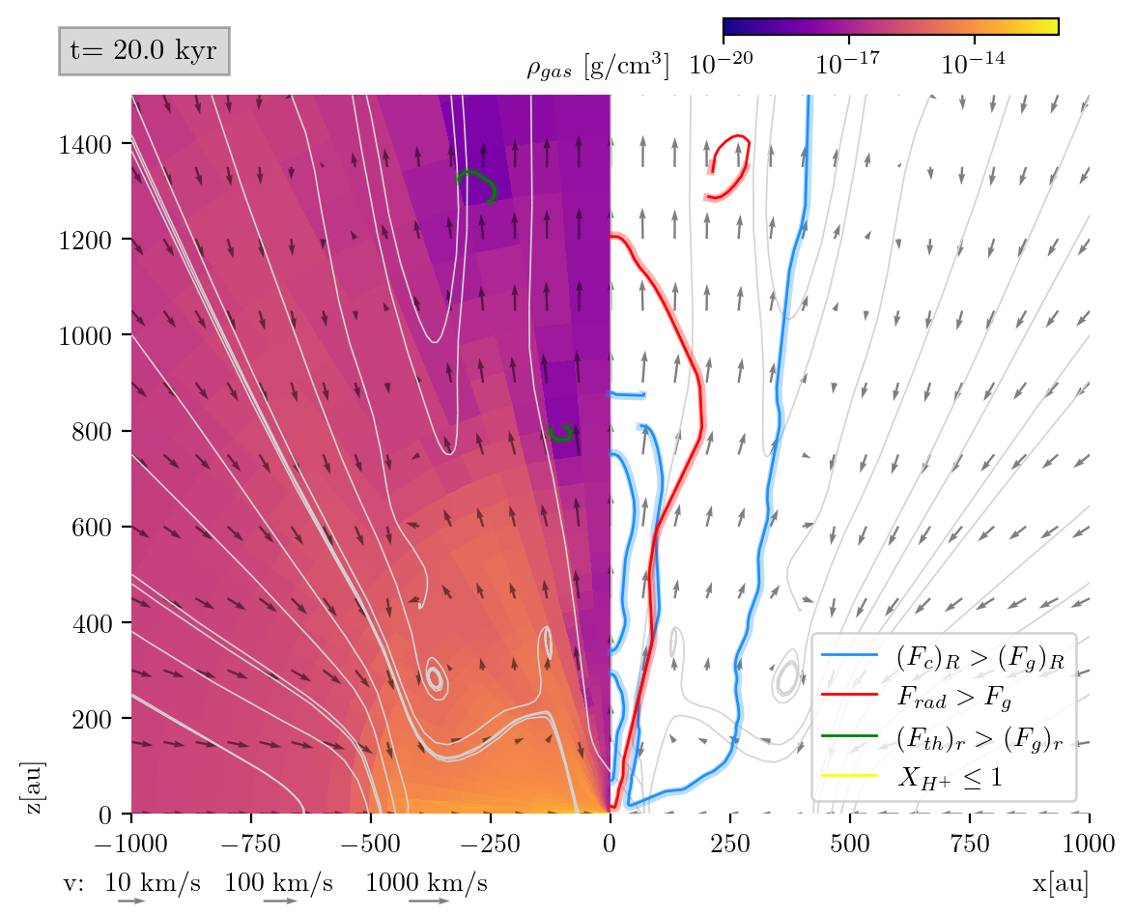
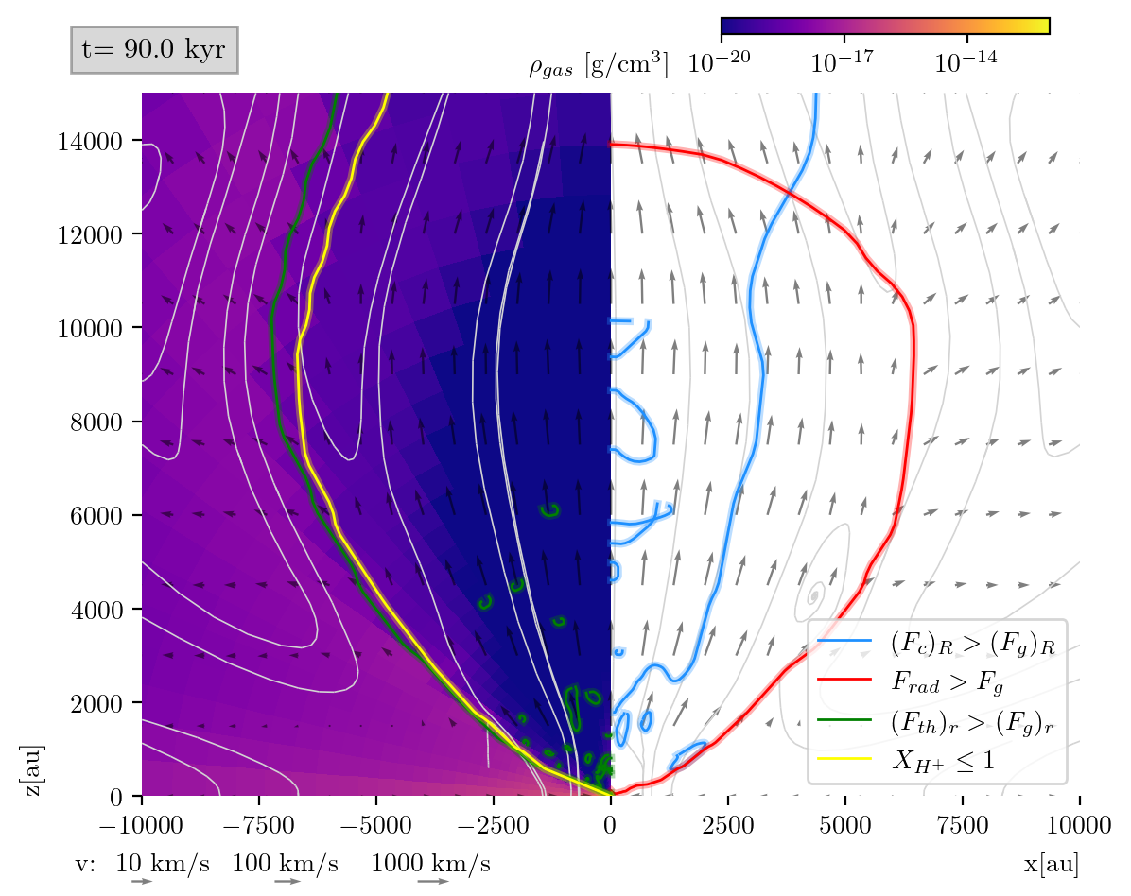
Outflows in the cavity
$${\vec{F}}_{rad}=\frac{χ_{abs} G}{c}\hat{r}$$
$${\vec{F}}_{th}=ρ∇_{r}P_{th} \hat{r}$$
Included Forces
$${\vec{F}}_{g}=\frac{G ρ M_{⋆}}{r^{2}} \hat{r}$$
$${\vec{F}}_{c}=ρ\frac{ v^{2}}{R} \hat{R}$$

Slide 8
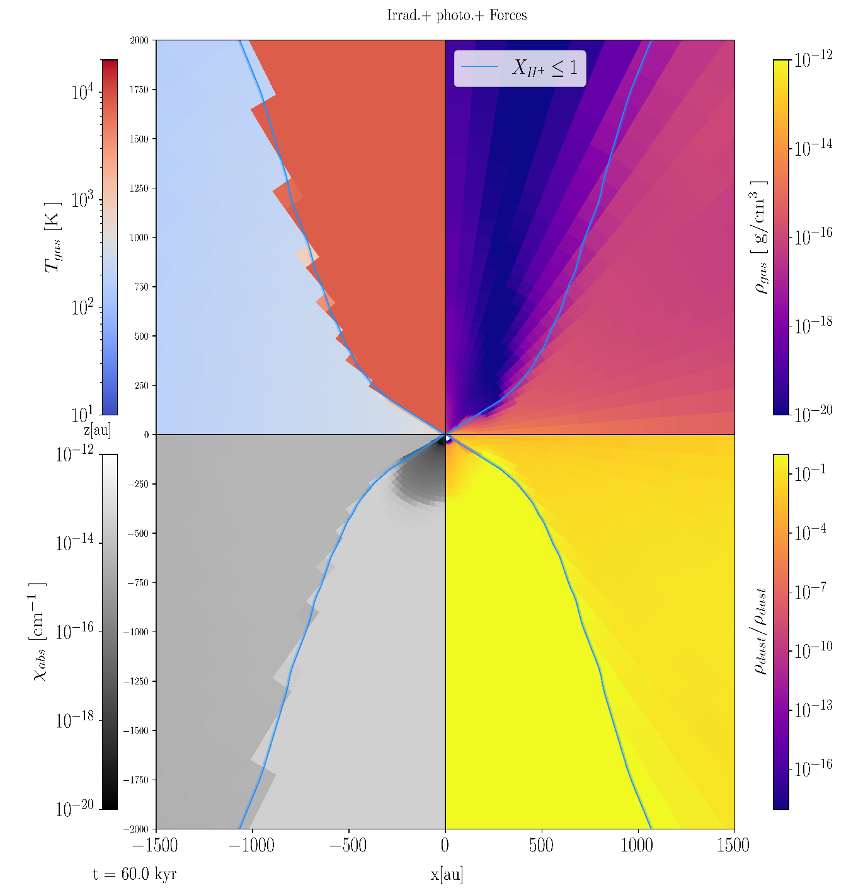
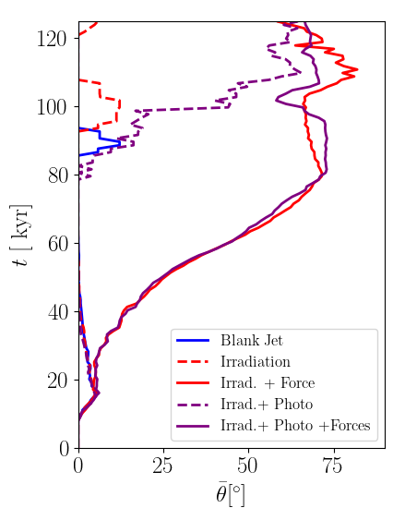
Cavity Broadening
At $t=60 kyr$
Photoionization starts
Radiation
Radiation
Jet
Notes:
The jet mechanism creates the cavity.
The H II region starts in the low-density cavity.
Cavity its hot and optically thin.
Radiation and photoionization are the main drivers.

Slide 9
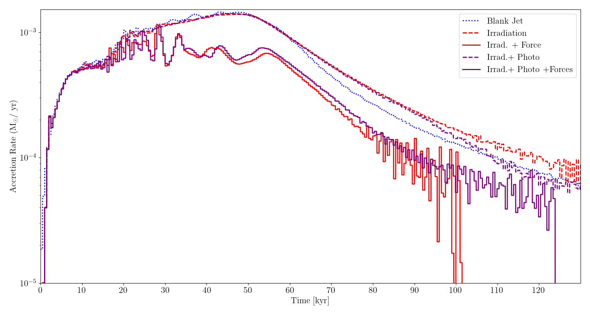
Accretion Rate
Photoionization starts
Magneto-centrifugal Jet
Radiation dominates the cavity!
Radiation shut-off accretion

Slide 10
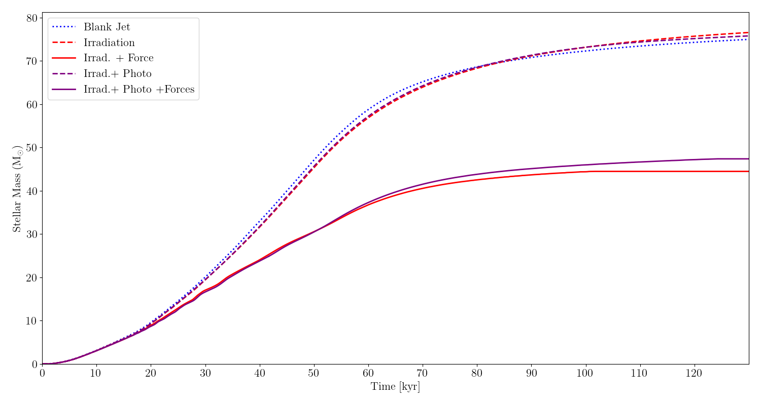
Stellar Mass
The presence of radiative effects plays a fundamental role in the final mass of the Star.
Photoionization slightly increases the final mass of the star with radiative feedback.

Slide 11
Conclusions
The presence of radiative effects significantly impacts the final status of the star.
Radiative feedback as a process is gradual and its influence cannot be modeled as previously studied.
Radiative pressure and photoionization reigns over the bipolar cavity and sets the main type of outflow.

Slide 12
Thank You! For your attention

Slide 13
Outlook
We desire to study this simulation with a bigger setup, changing from 0.1 to 1 pc, and adding more mass to the cloud.
Still remains a lot of questions regarding the overall dynamics from the outflows mainly by the presence of asymmetries.
This study lacks the conditions to study in detail the impact on angular momentum transfer from the disk to the star.
For proper understanding the effects that turbulence and the formation of asymmetries, they must be studied in 3D simulations.
It is considered necessary for future attempts to try higher resolution simulations to understand the smaller details in the simulation.

Slide 14
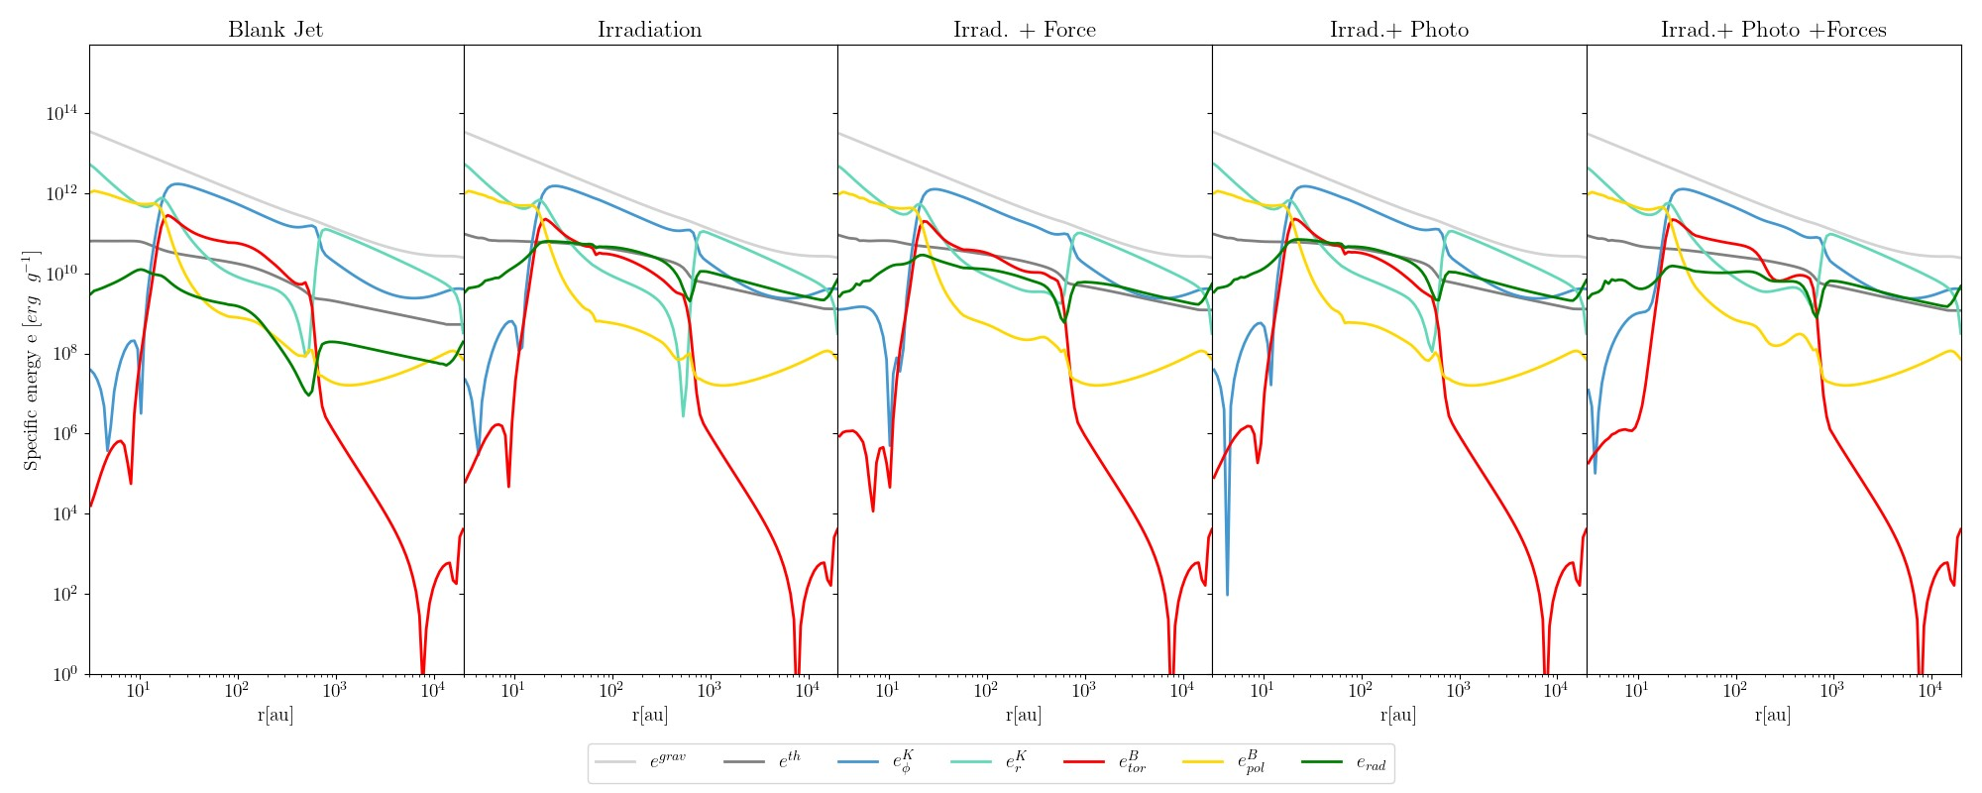
Results
Fig. 3: Comparison of the specific energies in early times. (t = 22.5 kyr).
In early times the disk is not affected by radiative effects.
Rather magnetic pressure, thermal pressure and magnetic braking defines accretion.
The magnetic braking region appears at $t≈15 kyr.$
It reduces the rotational kinetic energy, $e_{φ}^{K}$, and increases the infalling radial velocity.
Specific Energies

Slide 15
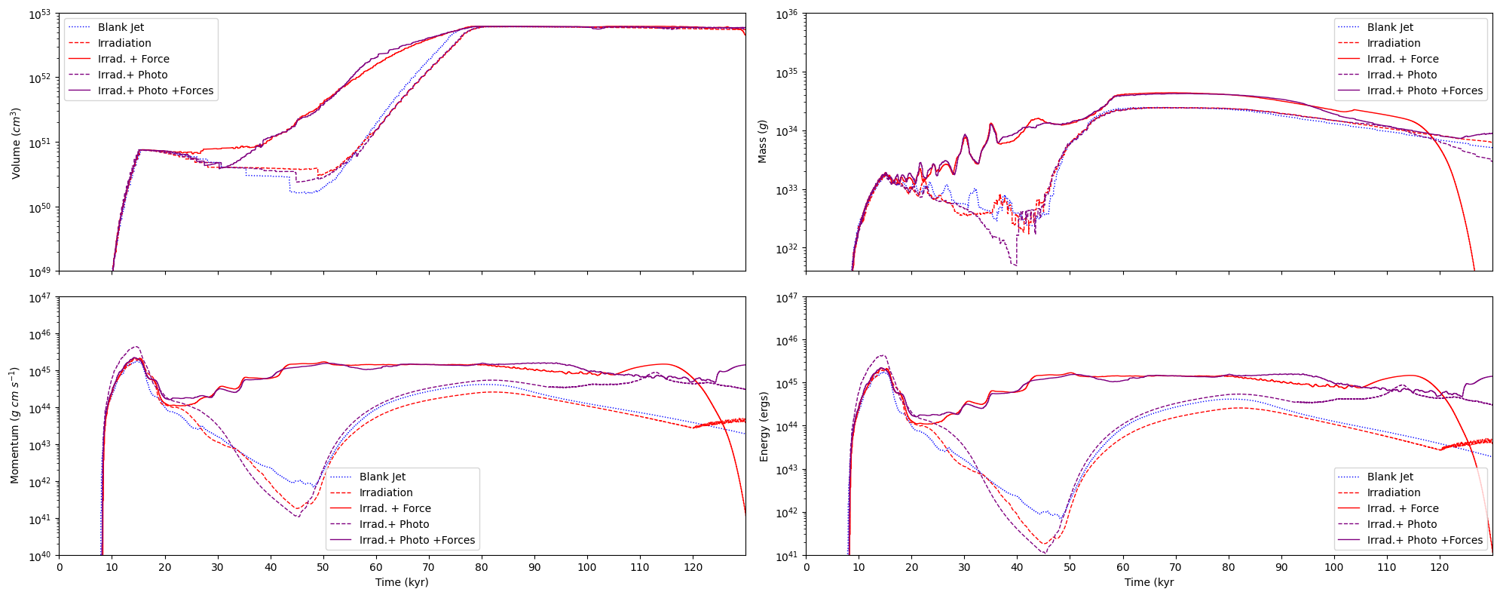
Results
Jet
Rad.+photo
Disk wind
Fig 12: Determination of the amount of the outflow volume, mass, linear momentum and energy.
Measuring the Outflows

Slide 16
Methodology
Simulating the collapse of the cloud
2.5D spherical simulations with high-radial resolution close to the central sink cell (star)
Physical Effects
Program/Module
MHD
PLUTO
Stellar Evolution
Computed from the stellar tracks from Hosokawa et al. (2009)
$$Stellar features$$
Self-gravity
HAUMEA
$$∇^{2}Φ=4π G ρ$$
Radiation Transport
$${\vec{F}}_{rad}=\frac{χ_{abs} G}{c}\hat{r}$$
MAKEMAKE
Photo-ionization
SEDNA
Updates the ionization fraction

